Slide 1
Professional JavaScript for
Web Development
Chapter-10 :The Document Object Model
PRESENTED BY:
DAW SAW THANDAR SHWE
LECTURER
ITSM DEPARTMENT
UNIVERSITY OF COMPUTER STUDIES (SITTWAY)
Information Technology Supporting and Maintenance

Slide 2

Outlines
What is DOM?
Hierarchy of Nodes
Node Type
Node Relationships
Document Object
Manipulating Nodes
Information Technology Supporting and Maintenance

Slide 3
What is DOM?
The Document Object Model (DOM) is an application programming interface (API) for HTML and XML documents.
When a web page loading, the browser creates a Document Object Model of the page.
DOM represents a document as a hierarchical tree of nodes
In the HTML DOM ,everything is a node
To add, remove, and modify individual parts of the page
The document itself is a document node
All HTML elements are element nodes
All HTML attributes are attribute nodes
Text inside HTML elements are text nodes
Comments are comment nodes
Information Technology Supporting and Maintenance

Slide 4
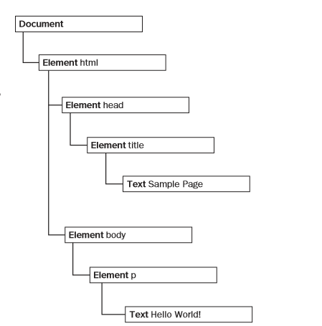
Hierarchy of Node
<!DOCTYPE html>
<html>
<head>
<title>Sample Page</title>
</head>
<body>
<p>Hello World!</p>
</body>
</html>
Information Technology Supporting and Maintenance

Slide 5
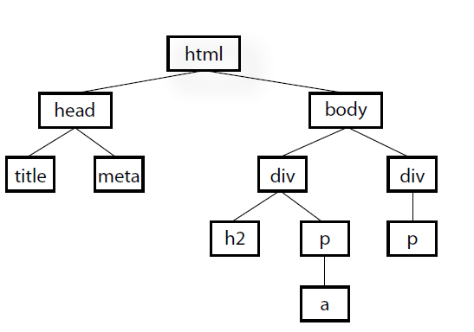
Hierarchy of Node Example:
<html>
<head>
<title>Document title</title>
<meta charset="utf-8">
</head>
<body>
<div>
<h2>Subhead</h2>
<p>Paragraph text with a <a href="foo.html">link</a> here.</p>
</div>
<div>
<p>More text here.</p>
</div>
</body>
</html>
Information Technology Supporting and Maintenance

Slide 6
The Node Type
Few note Type
Node.ELEMENT_NODE (1)
Node.ATTRIBUTE_NODE (2)
Node.TEXT_NODE (3)
Node.COMMENT_NODE (8)
Node.DOCUMENT_NODE (9)
Node.DOCUMENT_TYPE_NODE (10)
Information Technology Supporting and Maintenance

Slide 7
The nodeName and nodeValue Properties
The Document Type
nodeName is “#document”.
nodeValue is null.
The Element Type
nodeName is the element’s tag name.
nodeValue is null.
The Text Type
nodeName is “#text”.
nodeValue is text contained in the node.
The Attr Type
nodeName is the attribute name.
nodeValue is the attribute value.
Information Technology Supporting and Maintenance

Slide 8
Node Relationships
childNodes contains NodeList that is array-like object.
A NodeList object is a list (collection) of nodes extracted from a document.
Accessing childNodes
  firstChild (or) childNodes[0] (or) childNodes.item(0),
  childNodes[1] (or) childNodes.item(1)
  lastChild (or) childNodes[childNodes.length-1]
  previousSibling
  nextSibling
No.of childNodes
        childNodes.length
Information Technology Supporting and Maintenance

Slide 9
Node Relationships (Cont’d)
<ul>
<li> One</li>
<li>Two</li>
<li>Three</li>
</ul>
ul
firstChild
lastChild
parentNode
parentNode
parentNode
next
Sibling
next
Sibling
li
li
li
previous
Sibling
previous
Sibling
Information Technology Supporting and Maintenance

Slide 10
The Document Object
When an HTML document is loaded into a web browser, it becomes a document object.
is the root node of the HTML document
is the “owner” of all other nodes:( element nodes, text nodes, attribute nodes, and comment nodes)
provides properties and methods to access all nodes objects, from within JavaScript
Information Technology Supporting and Maintenance

Slide 11
Property And Method of Document Object
Methods /Property Description
document.getElementById() finding an element by element id
document.getElementsByTagName() finding an elements by tag name
document.getElementsByClassName() finding an elements by class name
element.setAttribute(attribute, value) Change the attribute value of an HTML element
element.getAttribute(attribute) Retrieve the attribute value of an HTML element
document.createElement() Create an HTML element
document.createAttribute() Create an HTML attribute
document.createTextNode() Create Text Node
element.innerHTML=new html content getting or replacing the content of HTML elements
element. attribute = new value Change the attribute value of an HTML element
element.style.property= new style Change the style of an HTML element
Information Technology Supporting and Maintenance

Slide 12
createElement( ) And createTextNode( )Example:
In HTML
Eg. <body>
<p>Hello World!</p>
</body>
Using DOM
eg. var p=document.createElement(“p”);
var txt=document.createTextNode(“Hello World!”);
p.appendChild(txt);
//append to the element
document.body.appendChild(p);
Information Technology Supporting and Maintenance

Slide 13
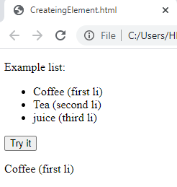
innerHTML property Example:
<p>Example list:</p>
<ul> <li>Coffee (first li)</li>
<li id="item">Tea (second li)</li>
<li>juice (third li) </li> </ul>
<button onclick="myFunction()">Try it</button>
<p id="demo"></p>
<script>
function myFunction() {
var x = document.getElementById("item2").previousSibling.innerHTML;
document.getElementById("demo").innerHTML = x;
}
</script>
Information Technology Supporting and Maintenance

Slide 14
Creating Attribute Node
Example:
In HTML
<body>
<div id= “myNewDiv” class= “box” >Hello! </div>
</body>
Using DOM
var thediv=document.createElement(“div”);
thediv.id=“ myNewDiv”;
thediv.className= “box”;
Information Technology Supporting and Maintenance

Slide 15
Creating Attribute Node (Cont’d)
(OR)
thediv.setAttribute(“id”, “myNewDiv”);
thediv.setAttribute(“className”, “box”);
(OR)
var theattr=document.createAttribute (“id”);
id.value= “myNewDiv”;
thediv.setAttribute(theattr);
thediv.appendChild(document.createTextNode(“Hello!”));
document.body.appendChild(thediv); // The element can be added to the document tree.
Information Technology Supporting and Maintenance

Slide 16
DOM Standard Attributes
id, title, lang, dir (ltr, rtl) , classname
No. of Attribute
element.attributes.length;
eg. In Html
<body>
<div id= “mydiv” class=”bd” title=”Body Text” lang=”en” dir= “ltr”> Hello!</dir>
</body>
Information Technology Supporting and Maintenance

Slide 17
DOM Standard Attributes Cont’d:
Using DOM
<body>
<script type=”text/javascript”>
var div=document.createElement(“div”);
div.id= “mydiv”;
div.classname= “bd”;
div.title=”Body Text”;
div.lang=”en”;
div.dir=”ltr”;
div.appendChild(document.createTextNode(“Hello!”));
document.body.appendChild(div);
</script>
</body>
Information Technology Supporting and Maintenance

Slide 18
Getting Attribute
Example:
In HTML :
<div id=”myDiv” class=”bd” title=”Body text” lang=”en” dir=”ltr”></div>
All of the information specified by this element may be retrieved using the following JavaScript code:
  var div = document.getElementById(“myDiv”);
  alert(div.id); //”myDiv”
  alert(div.className); //”bd”
  alert(div.title); //”Body text”
  alert(div.lang); //”en”
  alert(div.dir); //”ltr”
Information Technology Supporting and Maintenance

Slide 19
Getting Attributes (Cont’d)
var div = document.getElementById(“myDiv”);
alert(div.getAttribute(“id”)); //”myDiv”
alert(div.getAttribute(“class”)); //”bd”
alert(div.getAttribute(“title”)); //”Body text”
alert(div.getAttribute(“lang”)); //”en”
alert(div.getAttribute(“dir”)); //”ltr”
<div id=”myDiv” my_special_attribute=”hello!”></div>
var value = div.getAttribute(“my_special_attribute”);
alert(value); //hello!
Information Technology Supporting and Maintenance

Slide 20
Changing Attribute Value
to change each of the attributes by assigning new values to the properties:
  div.id = “someOtherId”;
  div.className = “ft”;
  div.title = “Some other text”;
  div.lang = “fr”;
  div.dir =”rtl”;
Information Technology Supporting and Maintenance

Slide 21
Manipulating Nodes
appendChild( )…… add an HTML Element ( accept one argument: new node, add a node to end of childNodes list, return new node)
insertBefore( )…….. accept two arguments: node to insert and node to reference, insert new node before reference node, return new node
replaceChild( )……. .. replace an HTML Element ( accept two arguments: the node to insert and the node to replace, return node to replace)
removeChild( )……… Remove an HTML element (accept one argument: node to remove, return this node)
normalize( )…………. joined into a single text node
splitText( ) ………….. splits a text node into two text nodes
Information Technology Supporting and Maintenance

Slide 22
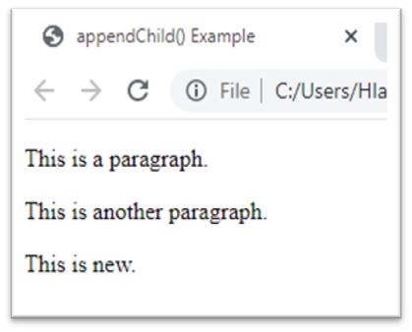
appendChild( ) Example:
<div id="div1">
<p id="p1">This is a paragraph.</p>
<p id="p2">This is another paragraph.</p>
</div>
<script type=“text/javascript”>
var para = document.createElement("p");
var node = document.createTextNode("This is new.");
para.appendChild(node);
var element = document.getElementById("div1");
element.appendChild(para);
</script>
Information Technology Supporting and Maintenance

Slide 23
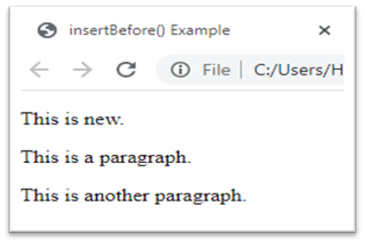
insertBefore( ) Example:
<div id="div1">
<p id="p1">This is a paragraph.</p>
<p id="p2">This is another paragraph.</p>
</div>
<script type=“text/javascript”>
var para = document.createElement("p");
var node = document.createTextNode("This is new.");
para.appendChild(node);
var element = document.getElementById("div1");
var child = document.getElementById("p1");
element.insertBefore(para, child);
</script>
Information Technology Supporting and Maintenance

Slide 24
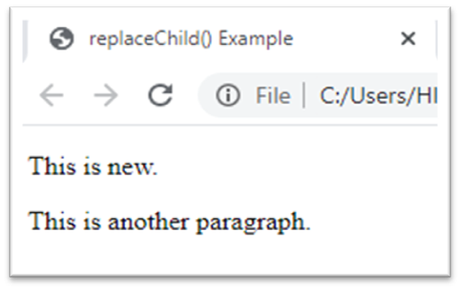
replaceChild( ) Example:
<div id="div1">
<p id="p1">This is a paragraph.</p>
<p id="p2">This is another paragraph.</p>
</div>
<script type=“text/javascript”>
var para = document.createElement("p");
var node = document.createTextNode("This is new.");
para.appendChild(node);
var parent = document.getElementById("div1");
var child = document.getElementById("p1");
parent.replaceChild(para, child);
</script>
Information Technology Supporting and Maintenance

Slide 25
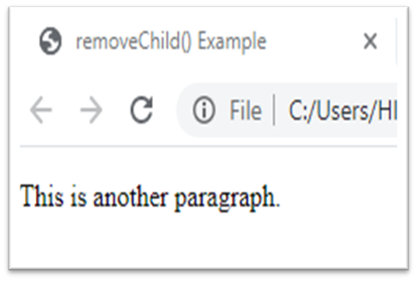
removeChild( ) Example:
<div id="div1">
<p id="p1">This is a paragraph.</p>
<p id="p2">This is another paragraph.</p>
</div>
<script type=“text/javascript”>
var parent = document.getElementById("div1");
var child = document.getElementById("p1");
parent.removeChild(child);
</script>
Information Technology Supporting and Maintenance

Slide 26
normalize( ) Example:
var element = document.createElement("div");
element.className ="message";
var textNode = document.createTextNode("Hello world!");
element.appendChild(textNode);
var anotherTextNode = document.createTextNode("welcome");
element.appendChild(anotherTextNode);
document.body.appendChild(element);
alert(element.childNodes.length); //2
element.normalize();
alert(element.childNodes.length); //1
alert(element.firstChild.nodeValue); //Hello world!welcome
Information Technology Supporting and Maintenance

Slide 27
splitText( ) Example:
var element = document.createElement("div");
element.className = "message";
var textNode = document.createTextNode("Hello world!");
element.appendChild(textNode);
document.body.appendChild(element);
var newNode = element.firstChild.splitText(5);
alert(element.firstChild.nodeValue); //“Hello"
alert(newNode.nodeValue); //“ world!"
alert(element.childNodes.length); //2
Information Technology Supporting and Maintenance

Slide 28
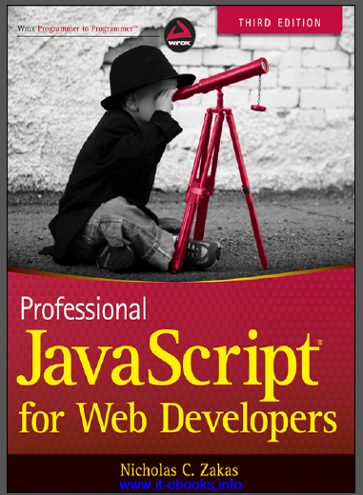
References
“PROFESSIONAL JavaScript for web Developers”
Third Edition
Zichalos C.Zakas
Nicholas, “Professional JavaScript for Web Development”
Colleen van Lent Ph.D, “INTERACTIVITY WITH JAVASCRIPT”
Information Technology Supporting and Maintenance

Slide 29
Thank You
1
Information Technology Supporting and Maintenance

